Slide 1
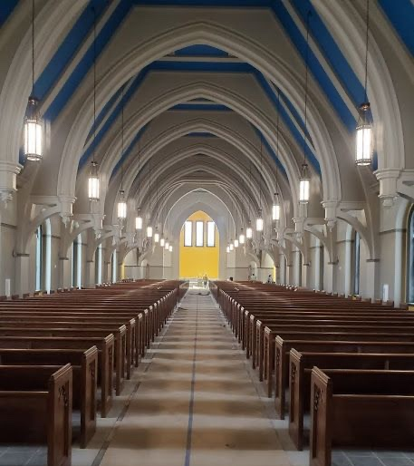
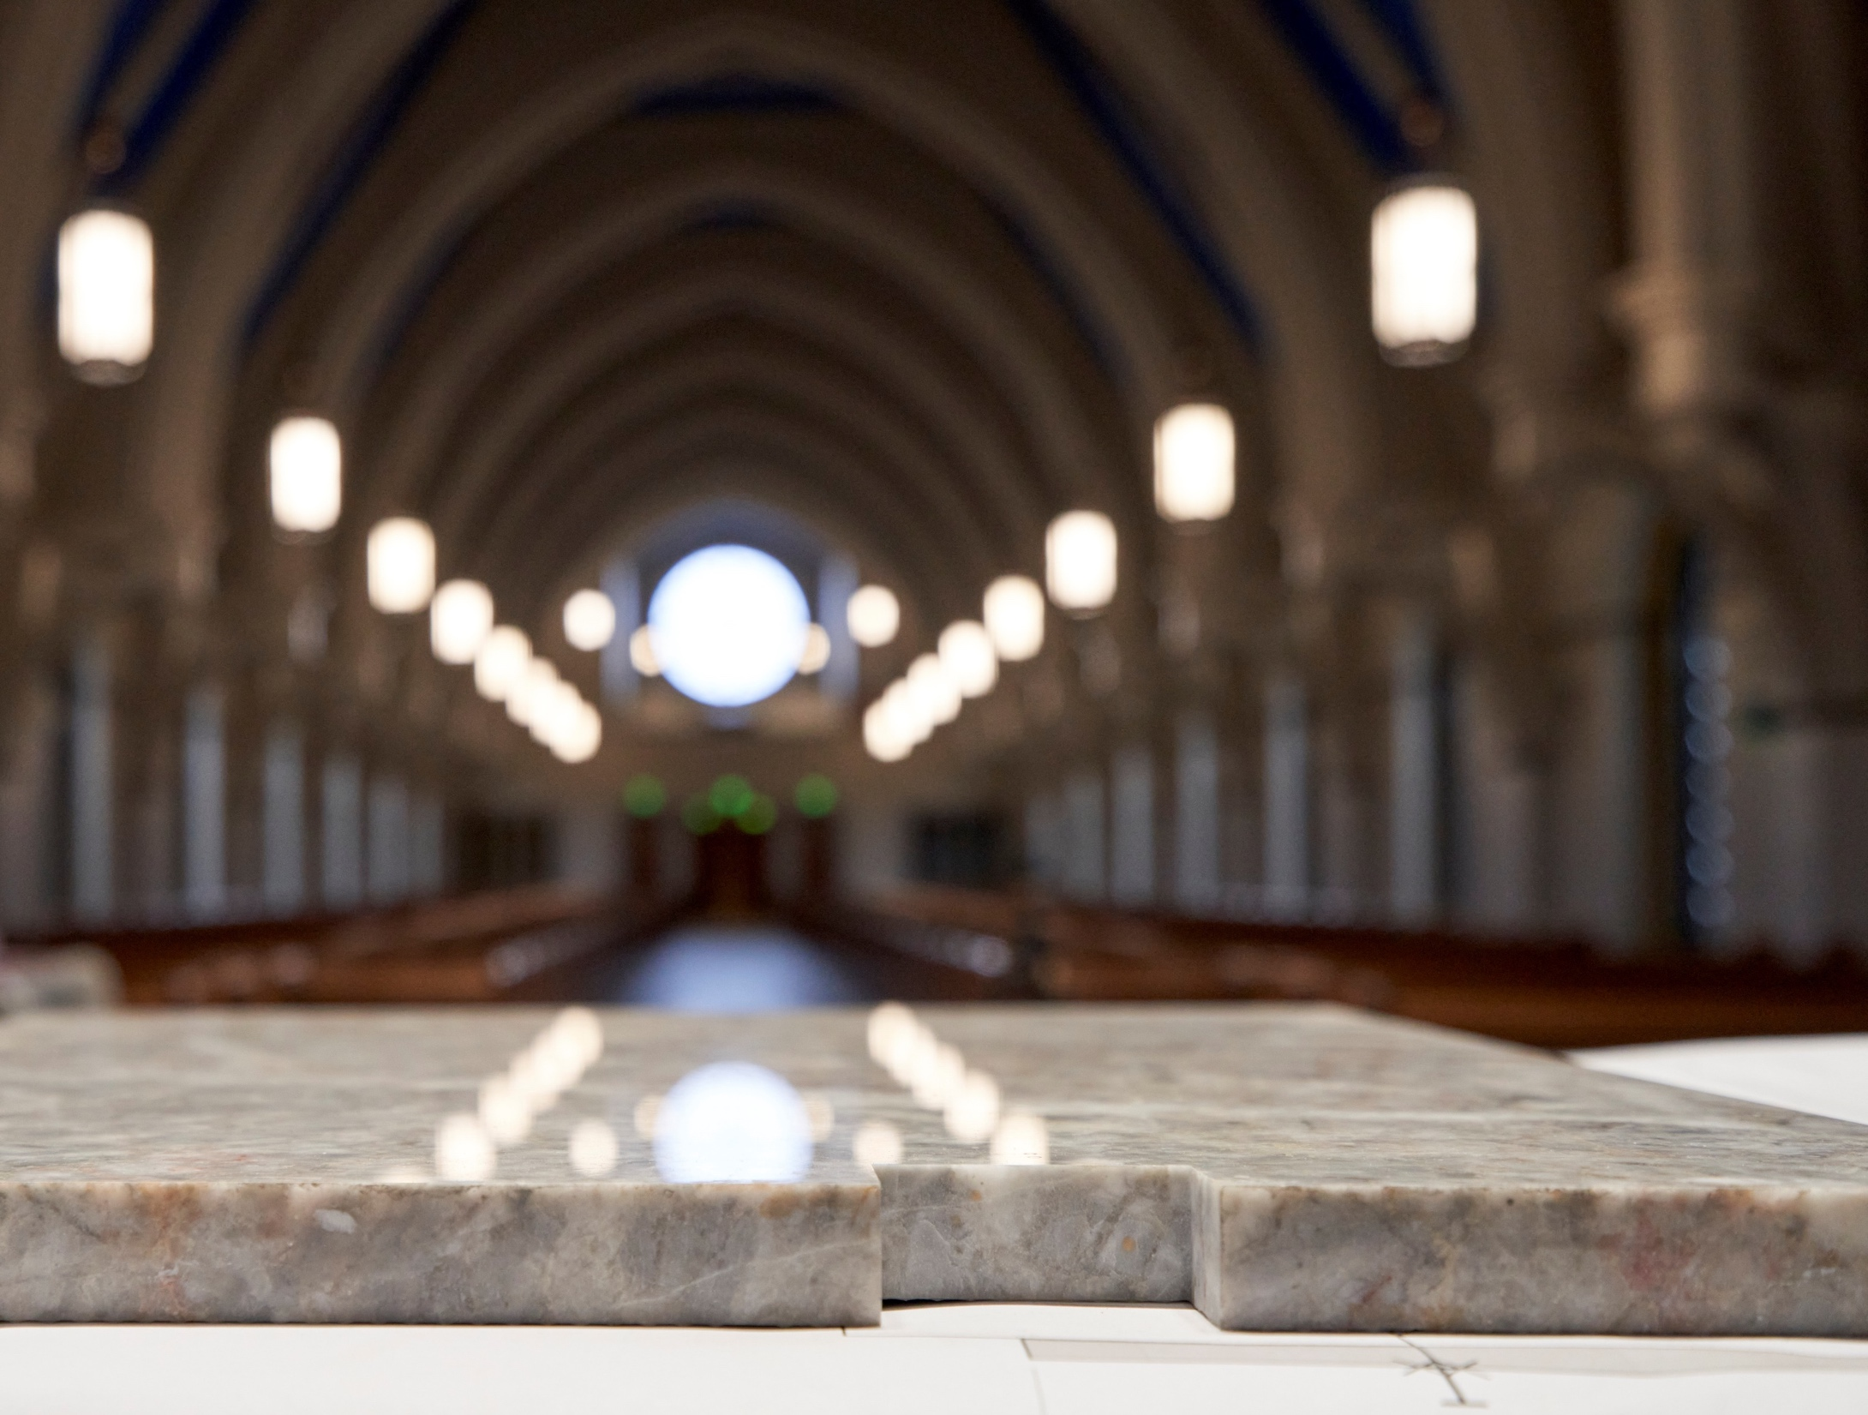
Corpus Christi
Memorial Campaign Booklet
3-year pledge opportunities

Slide 2
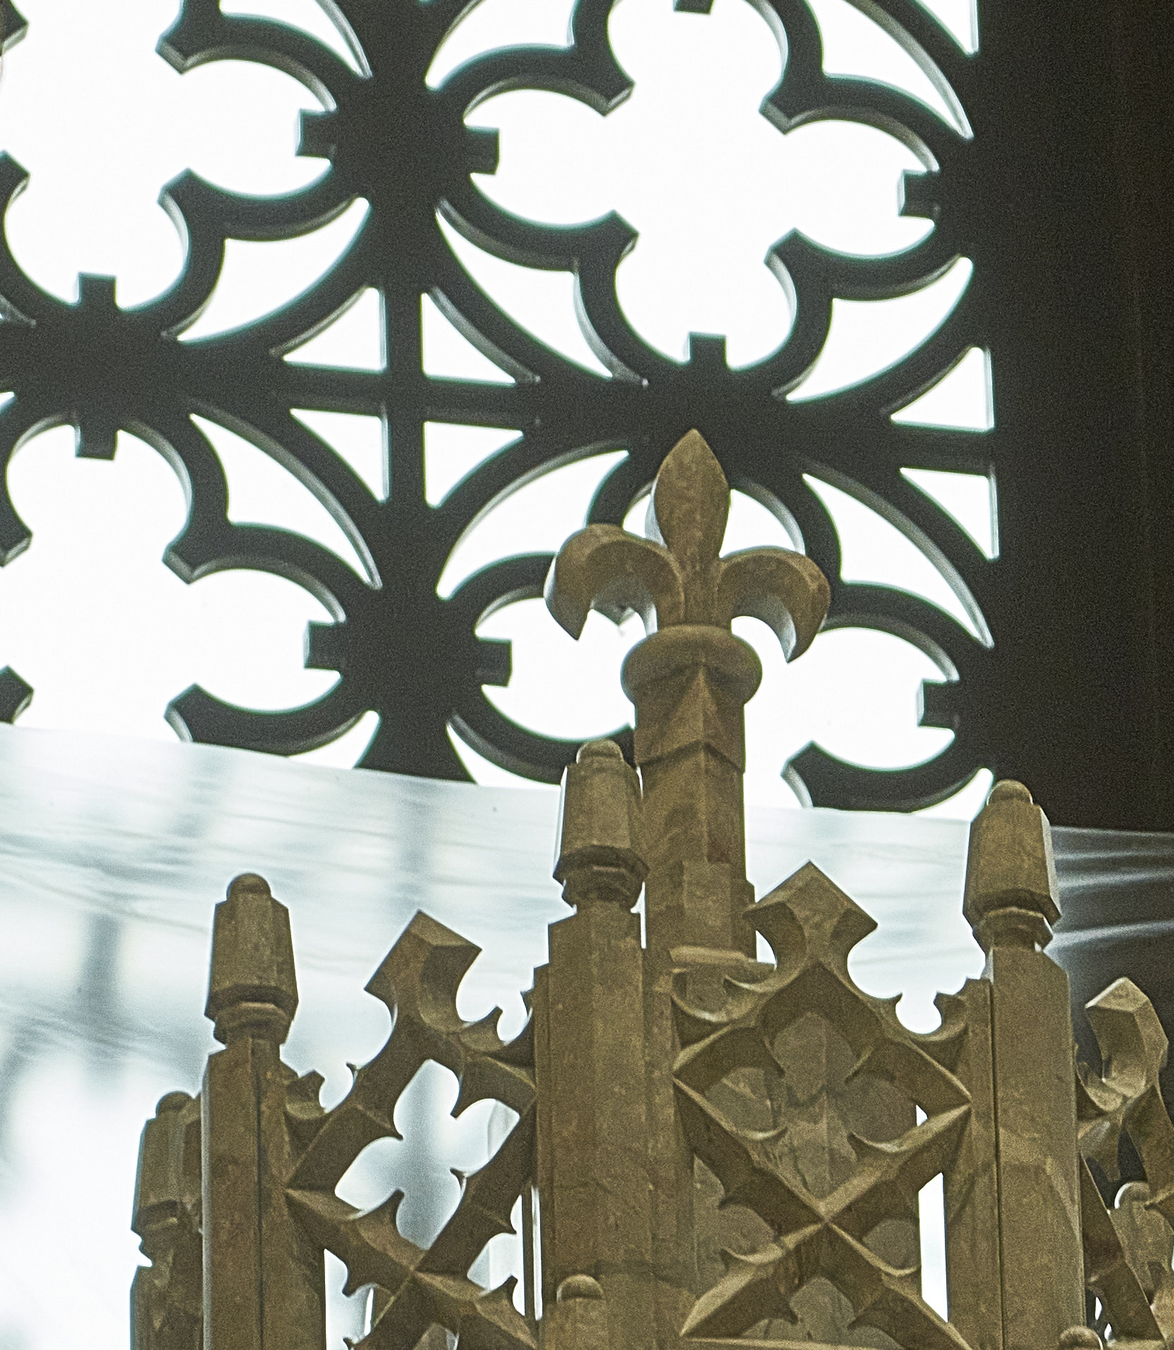
A Letter from our Pastor
Dear Parishioners,
Praise to Almighty God!
We have seen our hope of a church become a reality before our very eyes.
So much sacrifice and generosity by so many who call Corpus Christi Church home (and even donors from beyond our parish) have allowed us to be in the strong and encouraging position in which we find ourselves.
We have come to the point in our building process when so many of the items that make this sacred space truly sacred either have been or soon will be installed. This booklet is intended to provide an opportunity for parishioners to memorialize and gift specific items that are now or will be present in the church.*
As you view these items, please know of my gratitude for your continued support and generosity.
Sincerely in Christ,
Fr. Taylor
St. Joseph, Faithful Guardian of Christ, pray for us!

Slide 3
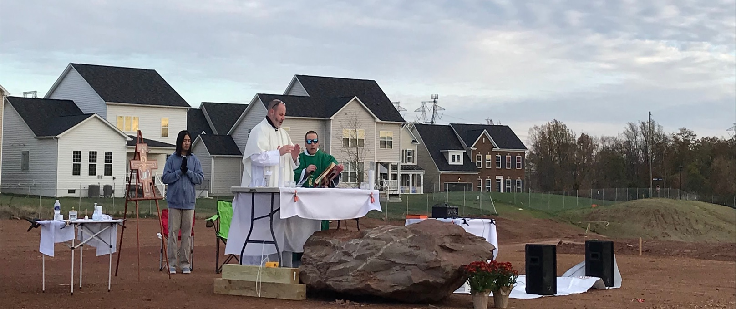
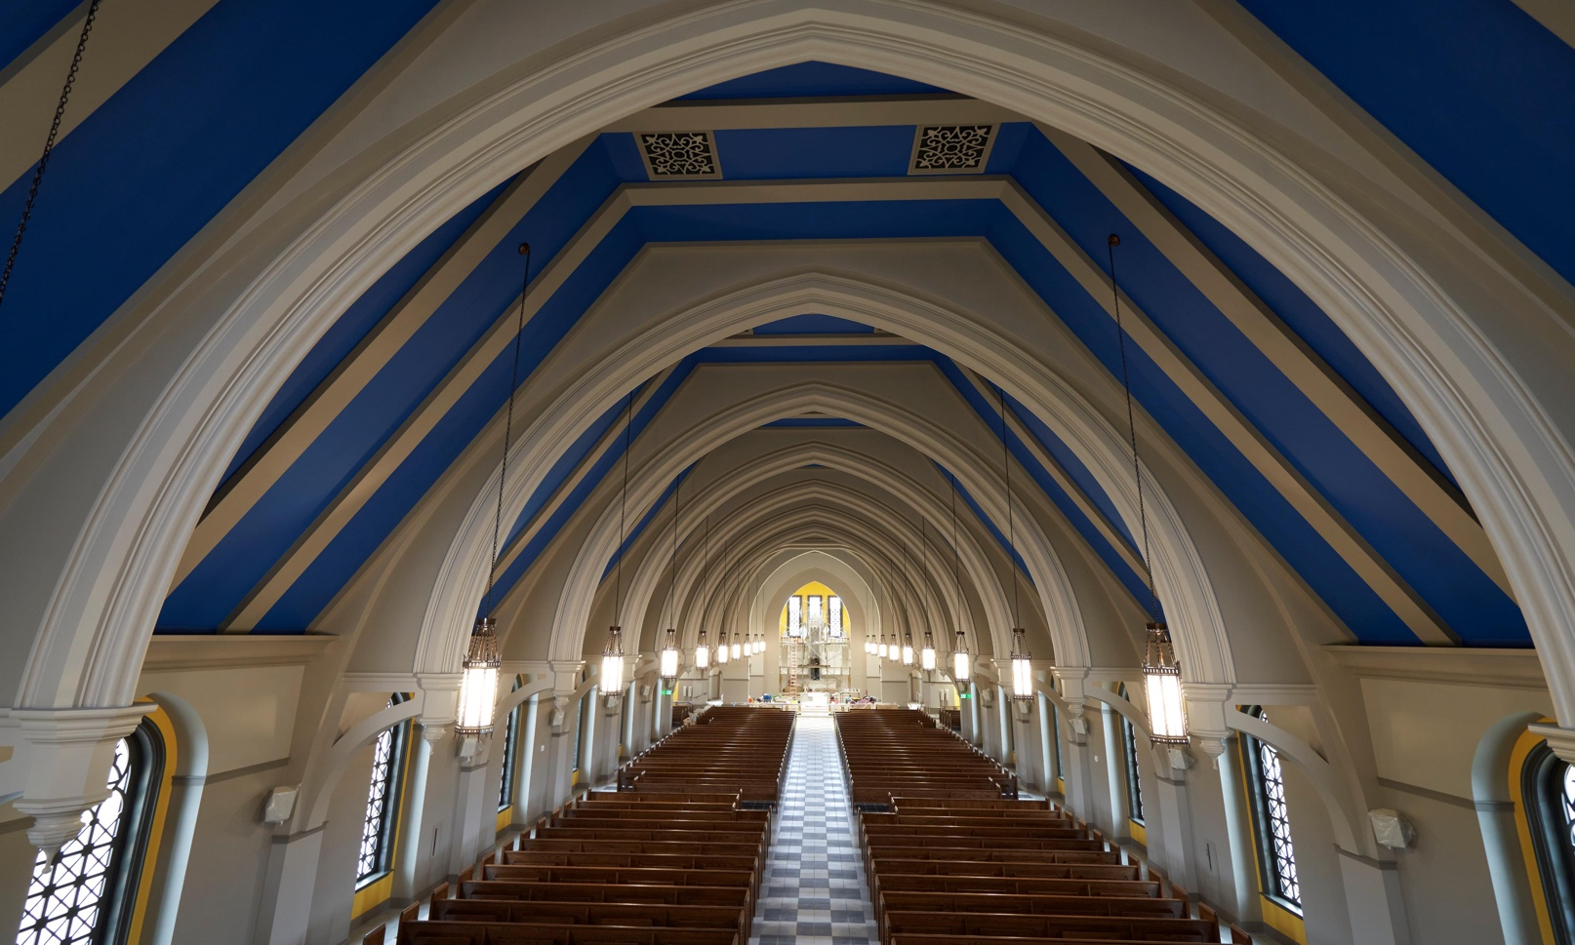
A little about our new Church
The Church is 256 feet long.
It is 94 feet wide at the transept and 54 feet wide at the nave.
The steeple is 111 feet high and can be seen from Route 50.
There is seating for approximately 1150 people on brand new pews!

Slide 4
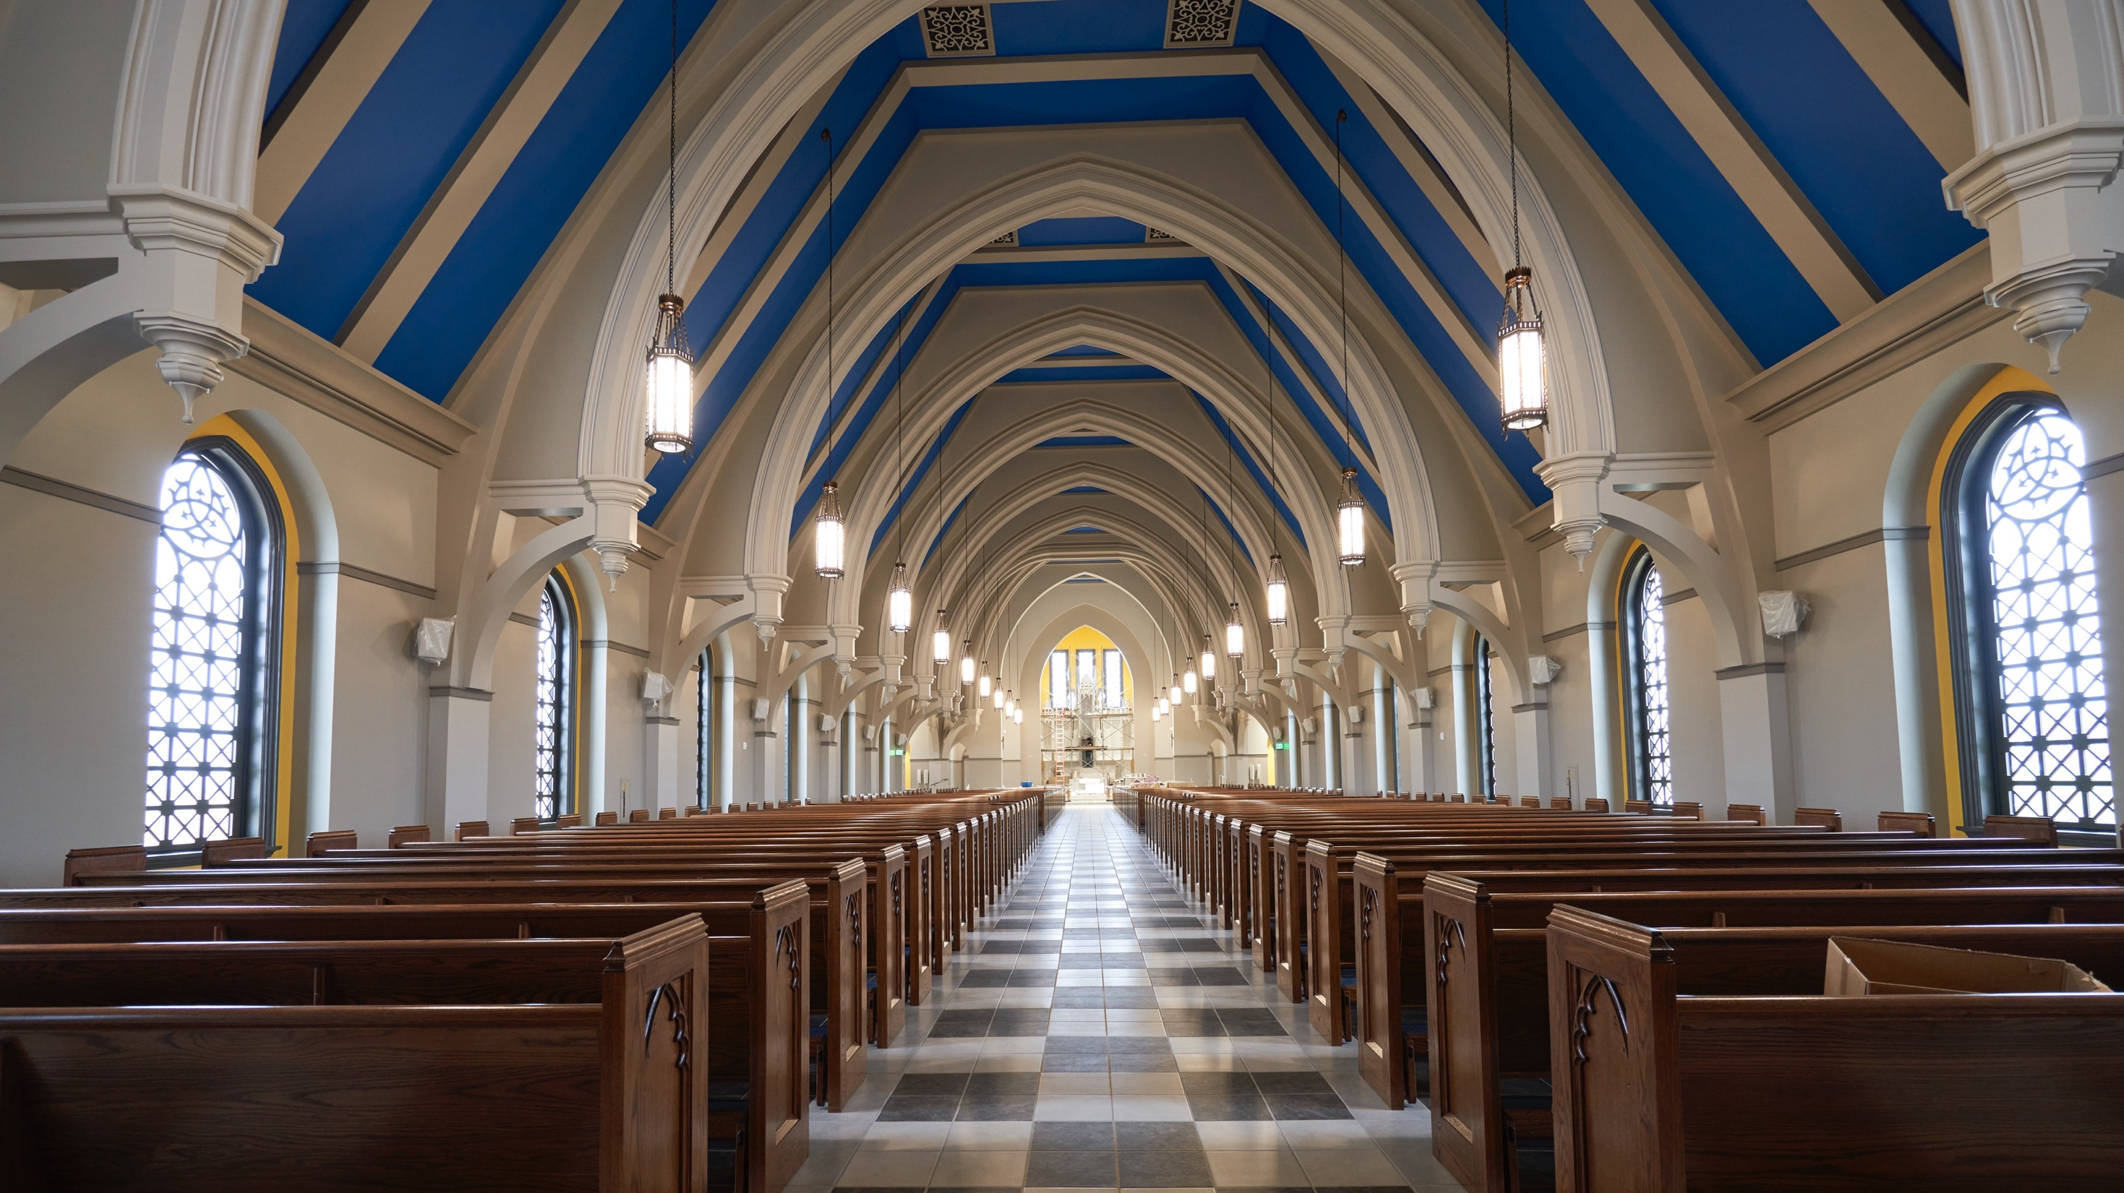
Memorialization Opportunities

Slide 5
The Building
Tympanum | Limestone Bricks | Nave Bracket & Capital | Arch
Sacristy Cabinetry

Slide 6
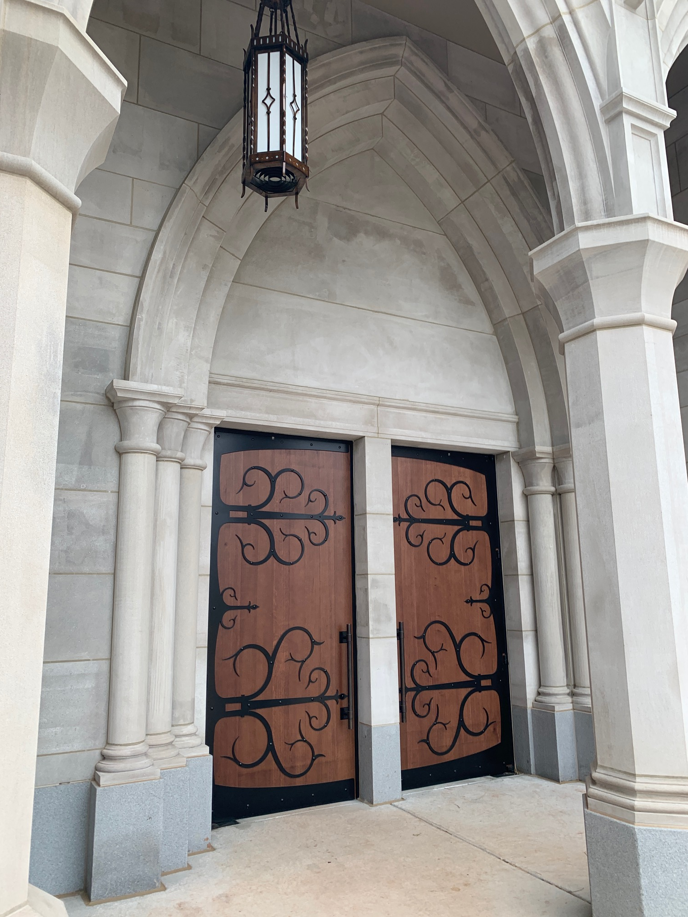
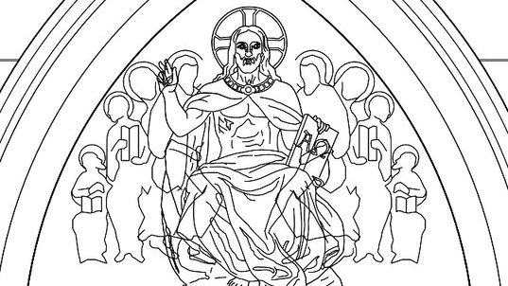
Tympanum
The tympanum will be crafted from limestone in a scene of Christ and Majesty. It sits on top of the main church door.

Slide 7
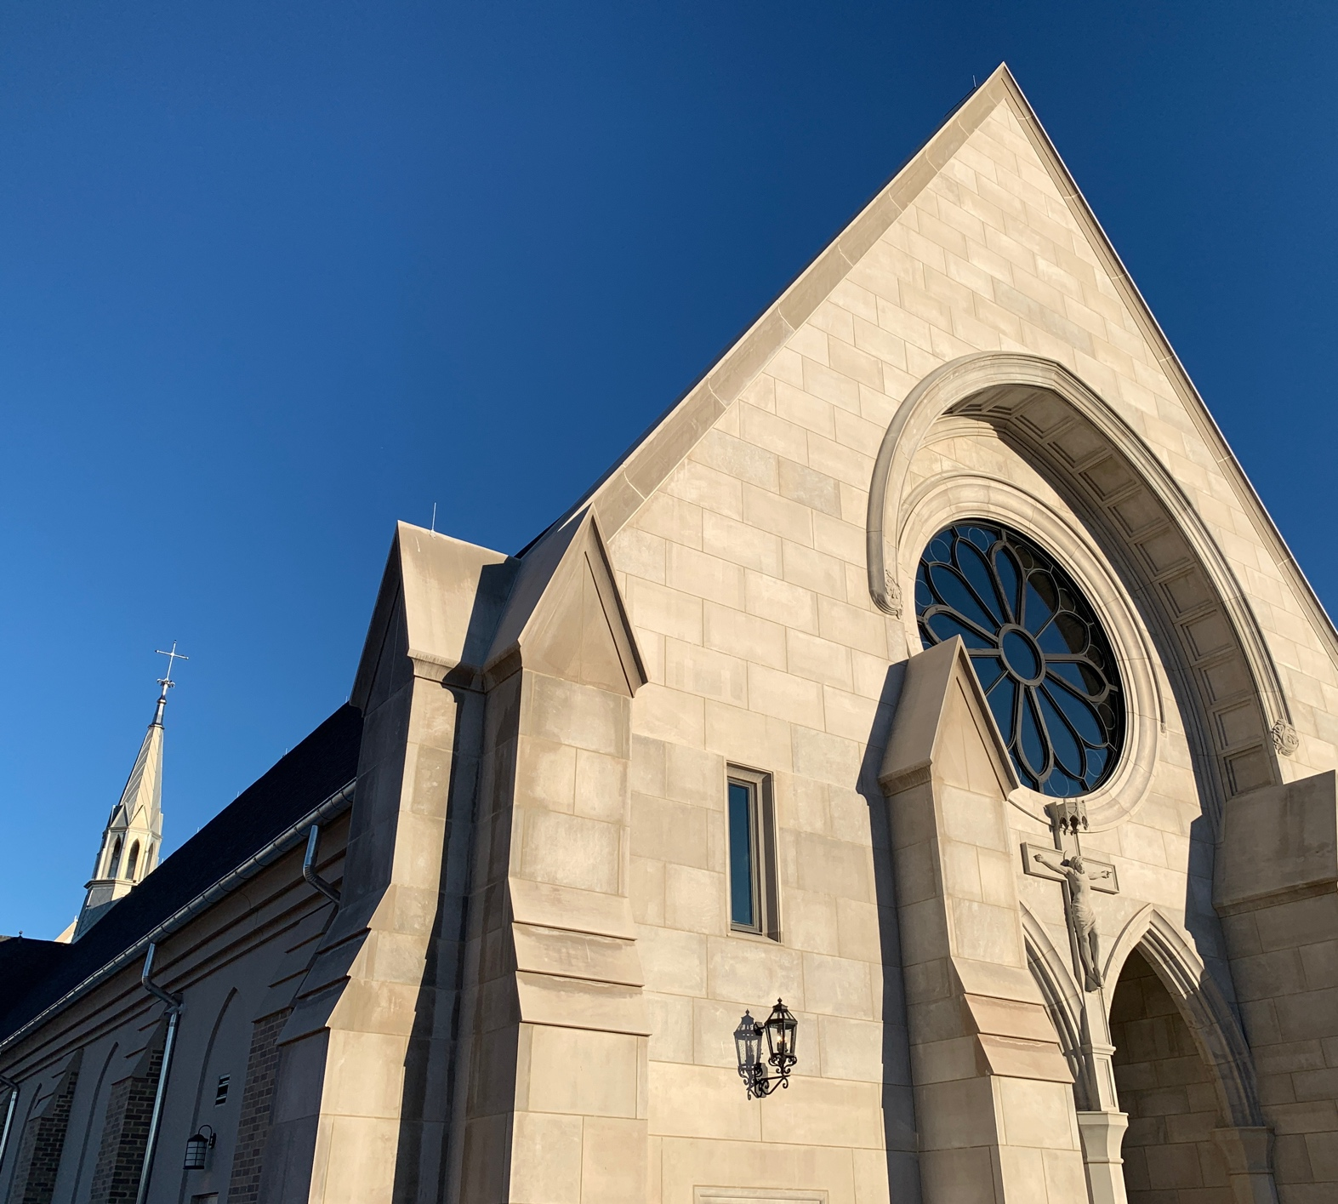
Limestone Blocks
The limestone blocks are used to cover the front façade of the building

Slide 8
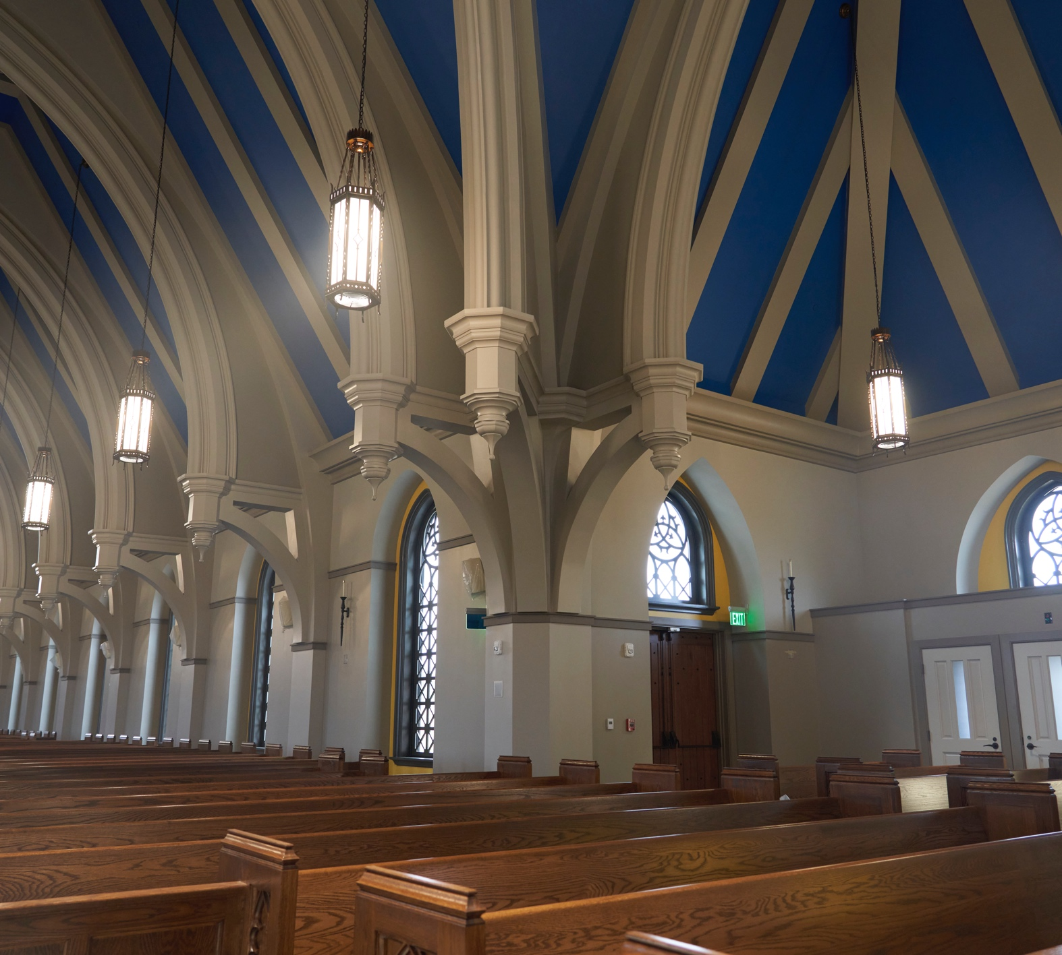
Nave Bracket and Capital
The nave brackets and capitals line the columns on both sides of the church.

Slide 9
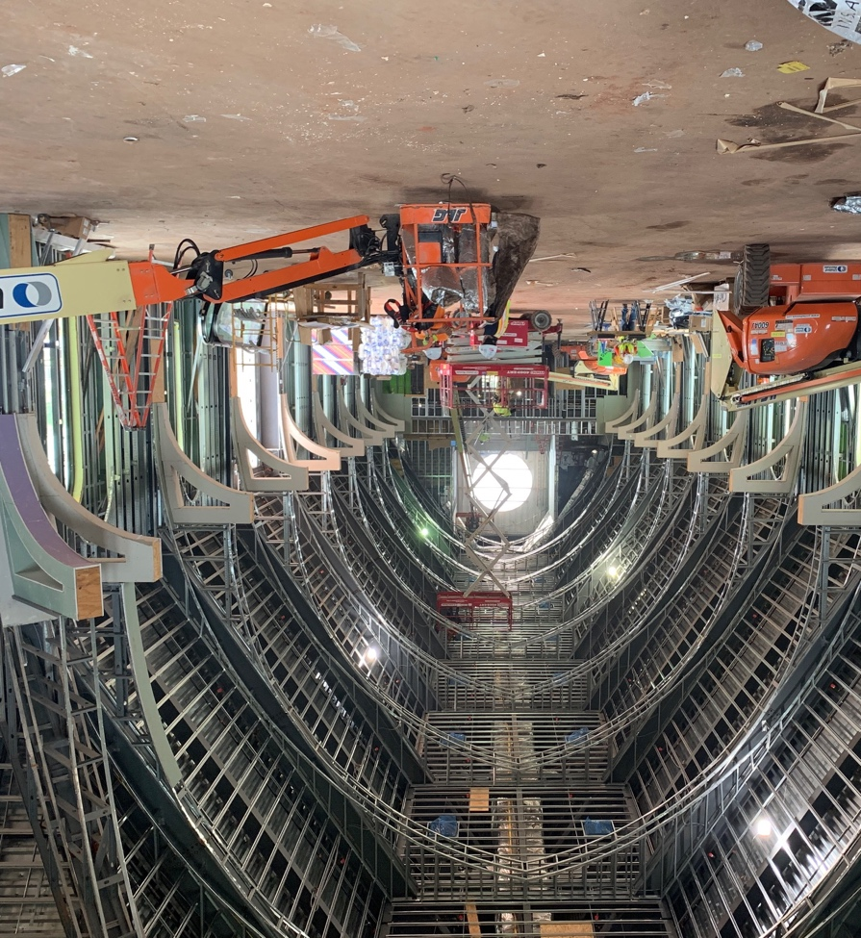
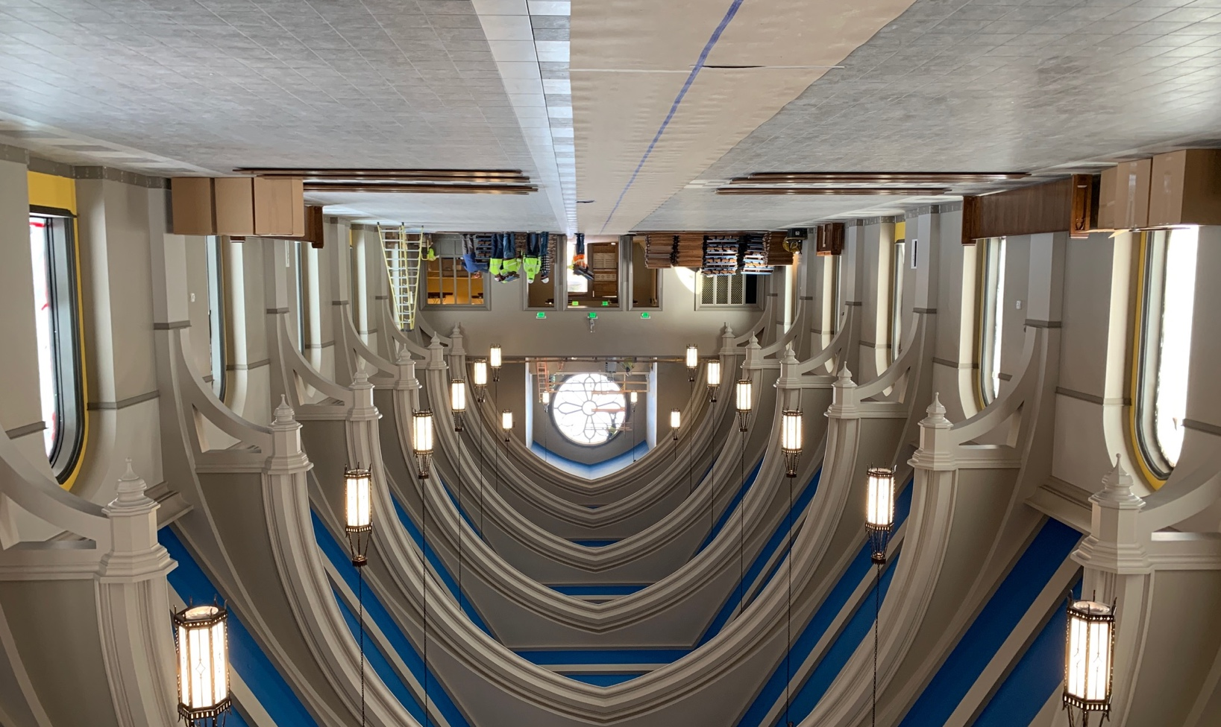
Arches
The arches are beautifully sculpted to match the marble in the rest of the church. They provide support for the roof over the nave.

Slide 10
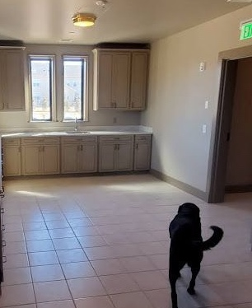
Sacristy Cabinetry
The sacristy cabinetry is used to hold liturgical supplies and the liturgical linens
(not for DJ’s treats!)

Slide 11
Asking Donation
(the building)
The Building | Asking Donation | Needed
Tympanum | $60,000 | 1
Limestone Bricks | $2,000 | 298
Nave Bracket & Capital | $5,500 | 22
Arch | $25,000 | 14
Sacristy Cabinetry | $30,000 | 1

Slide 12
The Sanctuary
Reredos | Altar of Sacrifice | Altar & Shrine Railing
Pulpit | Sedilia

Slide 13
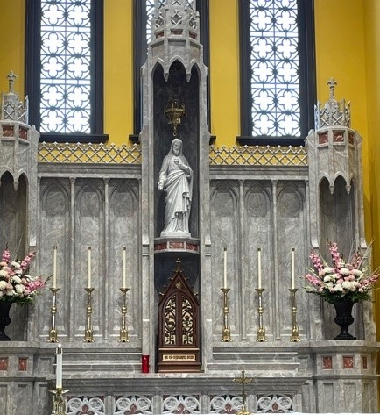
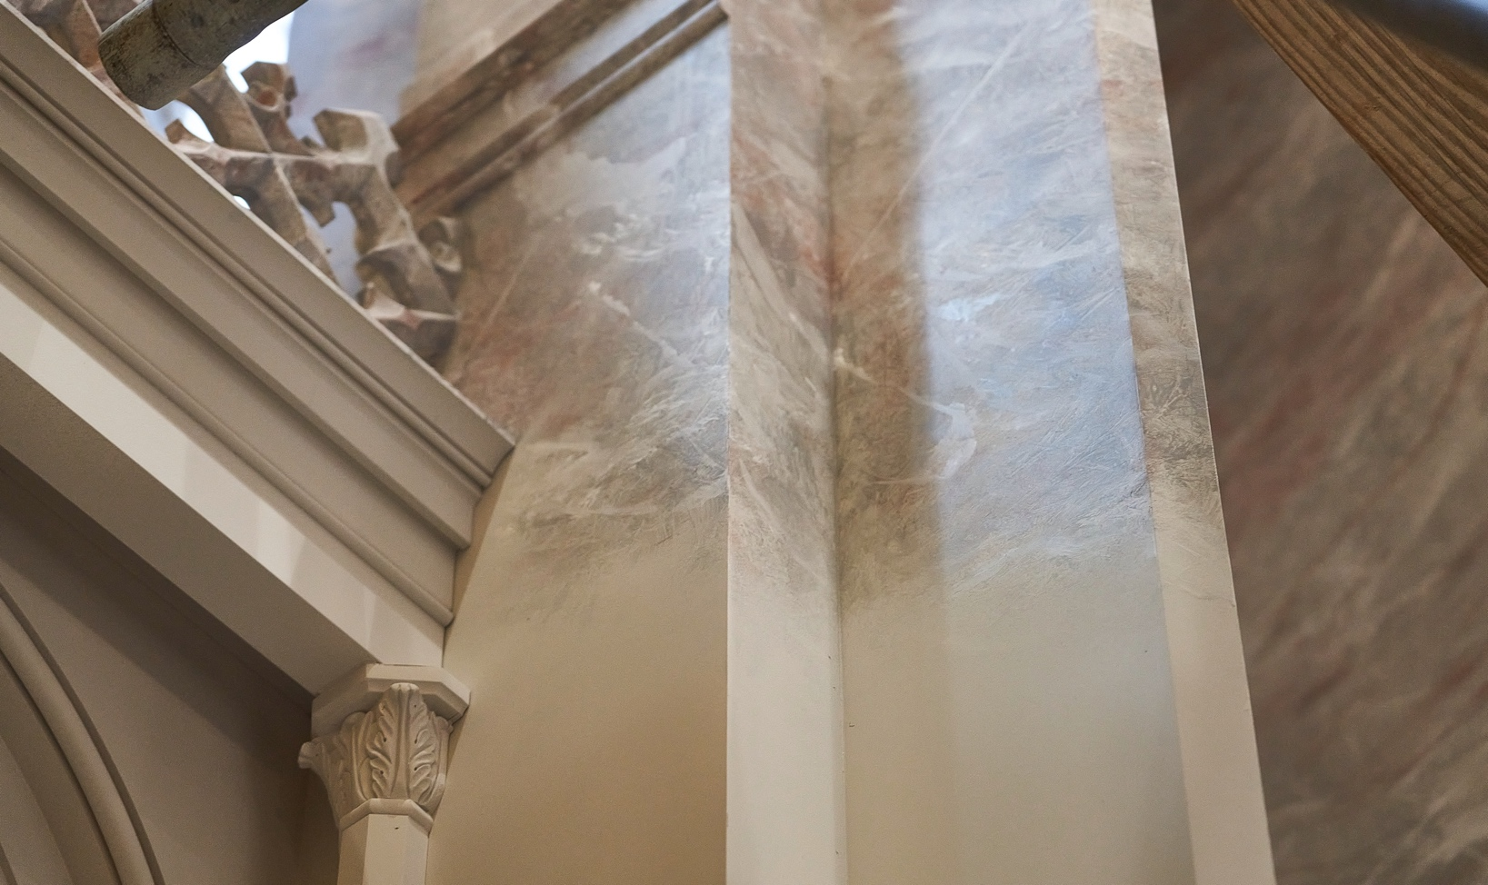
Reredos
The reredos is beautifully handcrafted to house the tabernacle. This piece was specifically commissioned for our new church. First constructed of wood and assembled on-site, it was then meticulously hand-painted to resemble marble in matching with the other altar pieces.

Slide 14
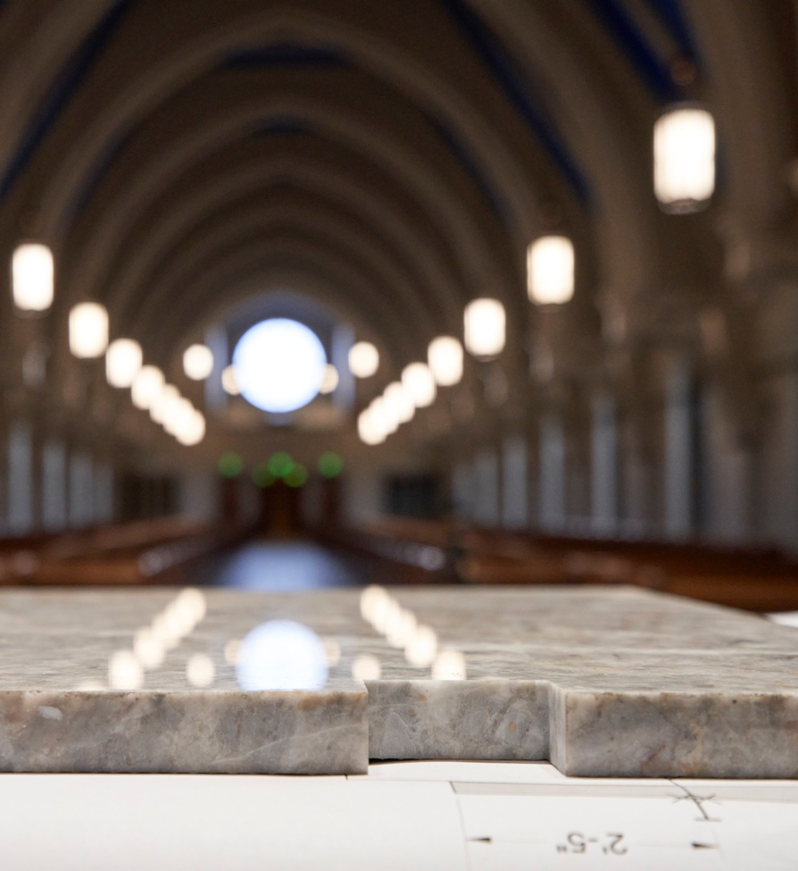
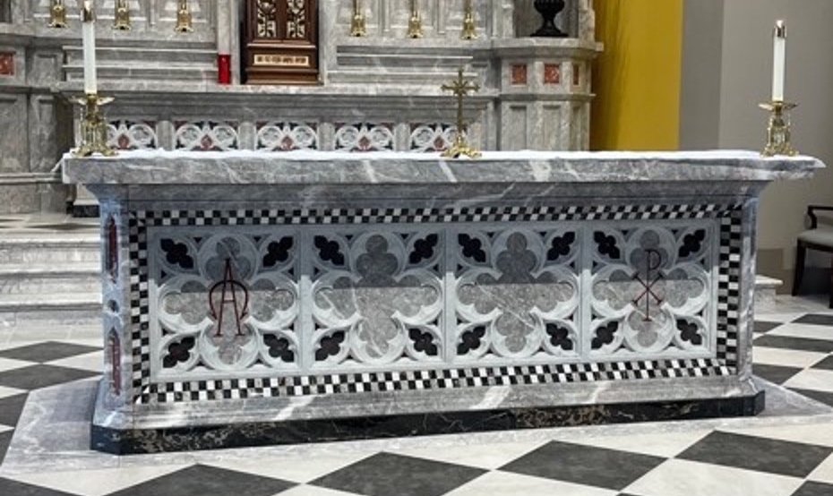
Altar of Sacrifice
The Altar of Sacrifice is located in the sanctuary, and it is made of several different colors of marble. It houses a first class relic of the Apostle St. Peter.

Slide 15
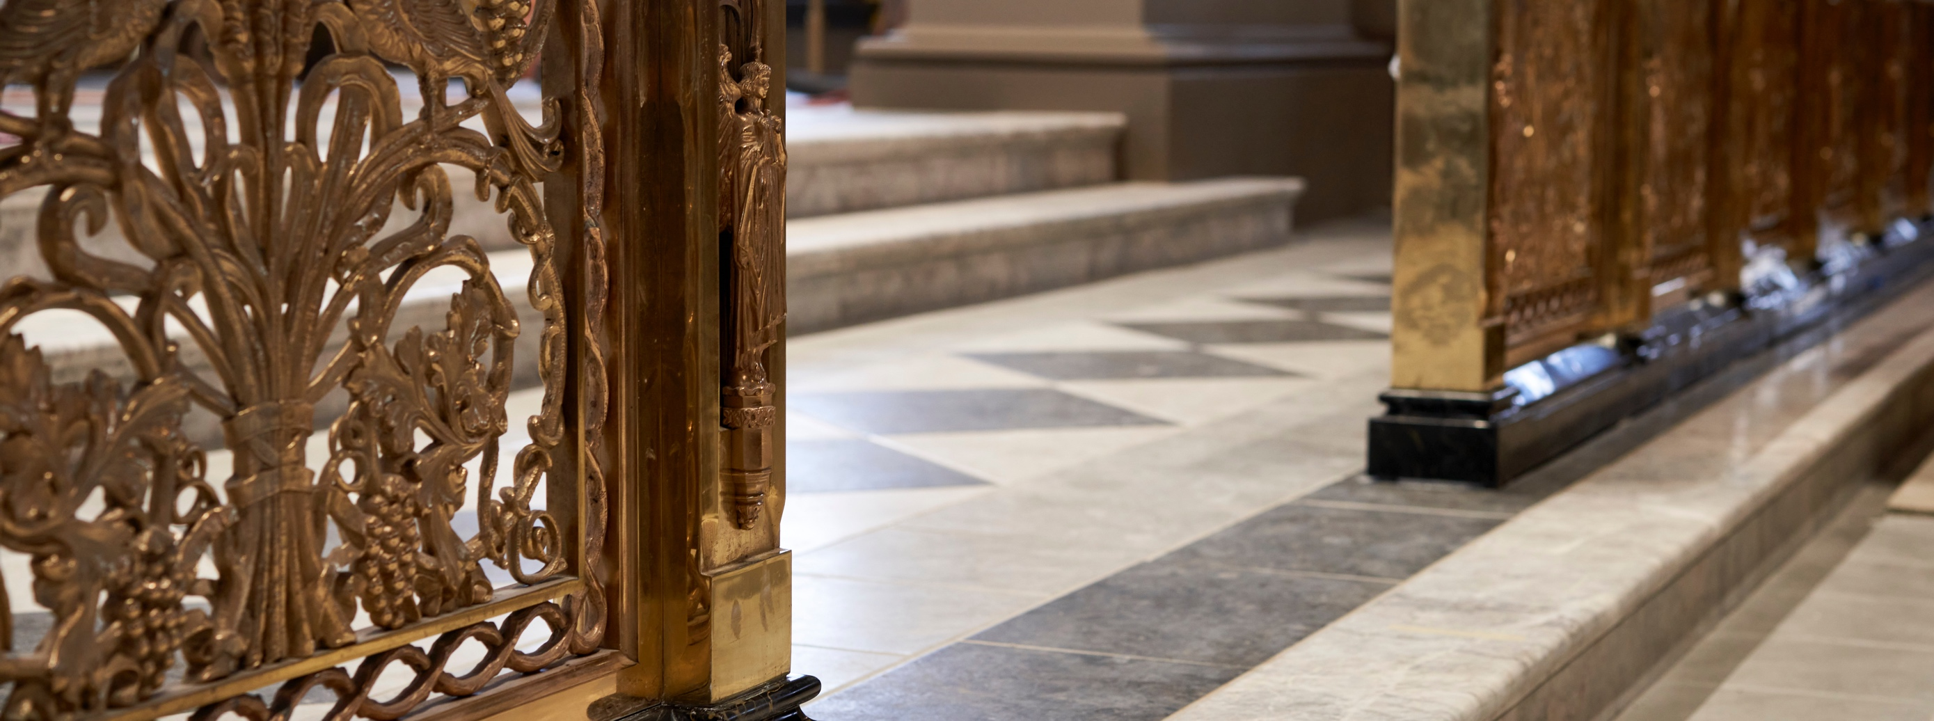
Railing
Communion and Shrines
Our Altar Rail is a rare and exceptional antique rail from the recently-closed St. Peter Catholic Church in Hartford, CT. St. Peter Church is a Gothic-style church and was the oldest Catholic Church in the state of Connecticut. It is comprised of marble, mahogany and polished brass and spans over fifty-five feet and has four gates.

Slide 16
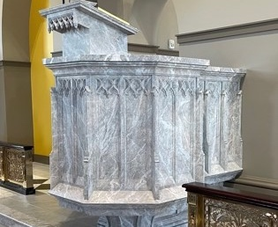
The Pulpit
The handcrafted pulpit is located to the left of the Altar of Sacrifice. It is the principal point of proclamation for the Word of God

Slide 17
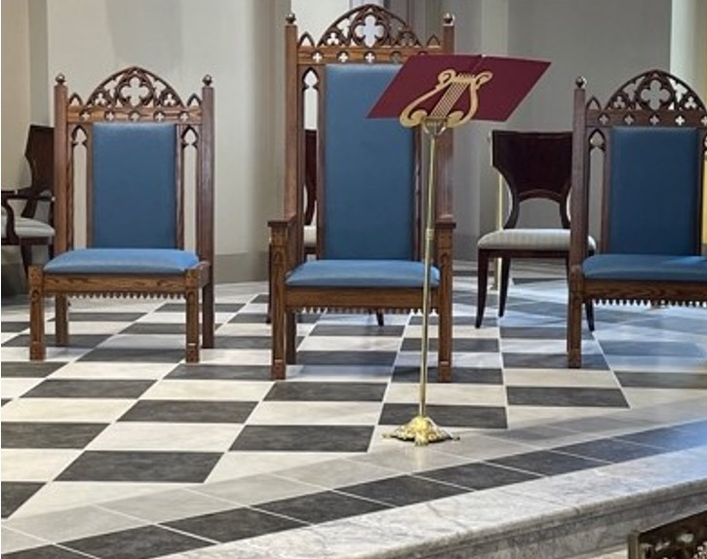
The Sedilia
The Sedilia (plural of Latin sedile, “seat”) are the ceremonial seats of the priest, deacon, and subdeacon placed to the south of the altar.
They were painstakingly hand-crafted from wood for Corpus Christi and evoke the same Gothic architectural principles found throughout the space.

Slide 18
Asking Donation
(the Sanctuary)
The Sanctuary | Asking Donation | Needed
Reredos | $85,000 | 1
Altar of Sacrifice | $100,000 | 1
Communion Rail | $50,000 | 1
Blessed Mother Shrine Railing | $10,000 | 1
St. Joseph Shrine Railing | $20,000 | 1
Pulpit | $40,000 | 1
Sedilia | $22,500 | 1

Slide 19
The Celebration
Bridal Room

Slide 20
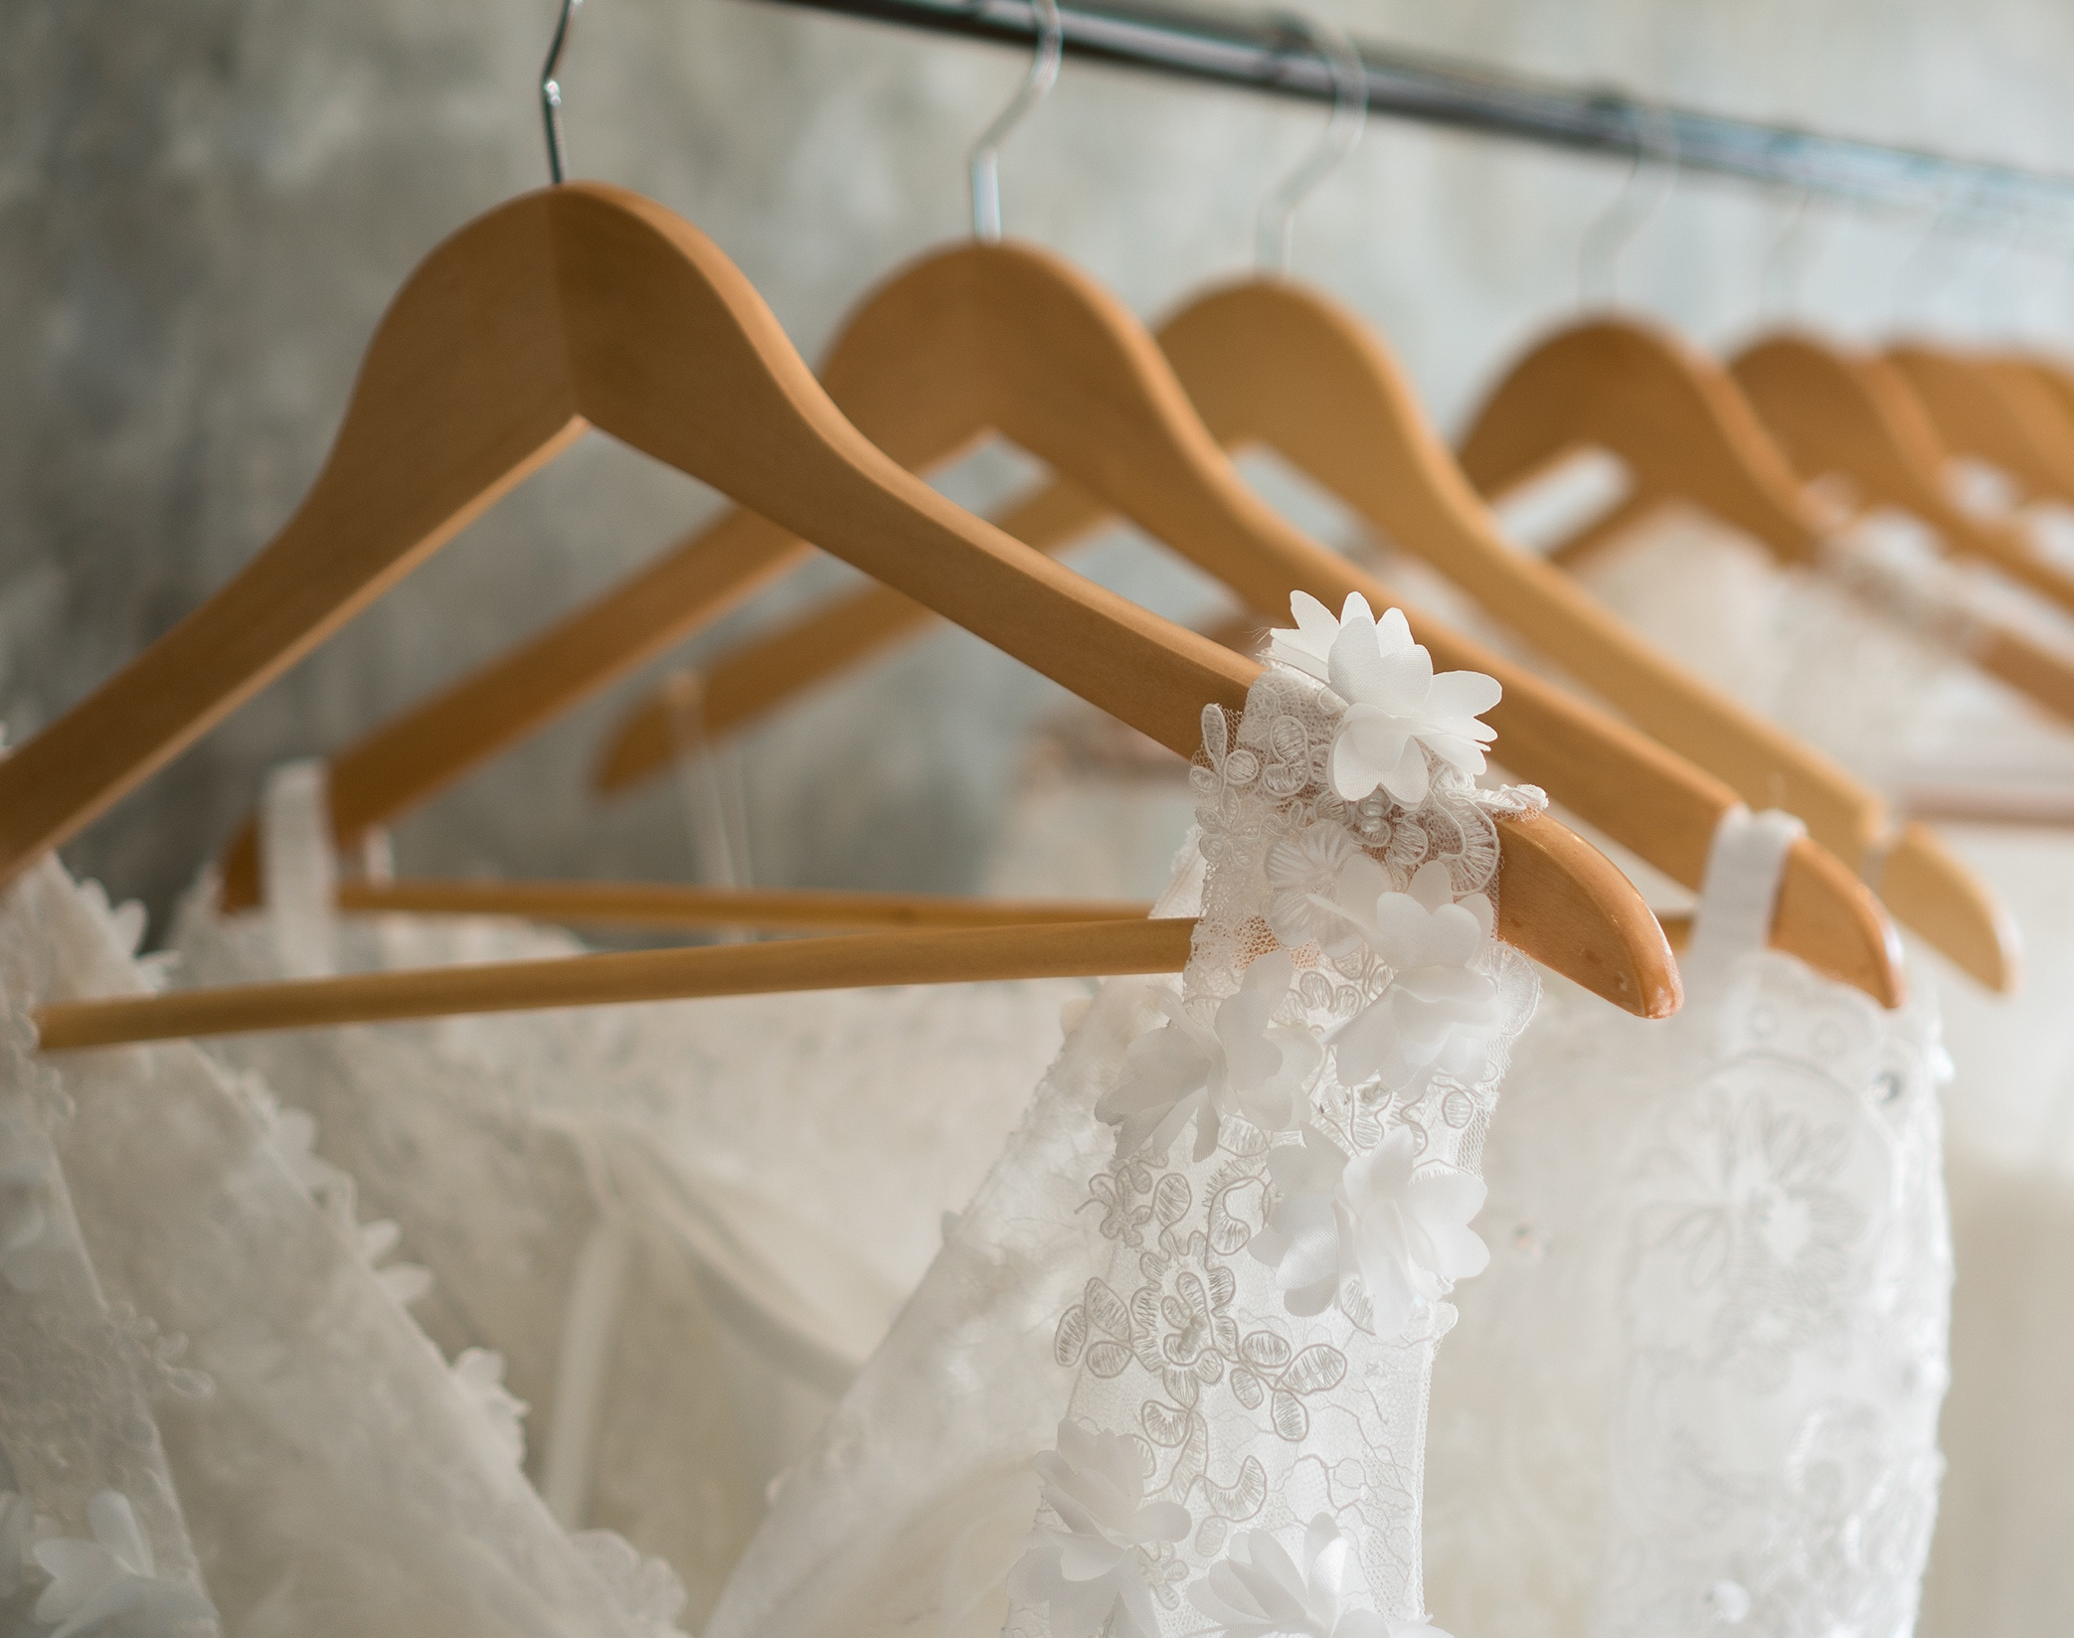
Bridal Room
Our bridal room provides a place of privacy for the final preparations of the bride and her party before their celebration of the Mass of Holy Matrimony and receipt of the Blessed Sacrament of Marriage.

Slide 21
Asking Donation
(the celebration)
The Celebration | Asking Donation | Needed
Bridal Room | $0 | 0

Slide 22
The Music
Choir Loft Risers | Sound System
Organ | Bronze Choir Railing

Slide 23
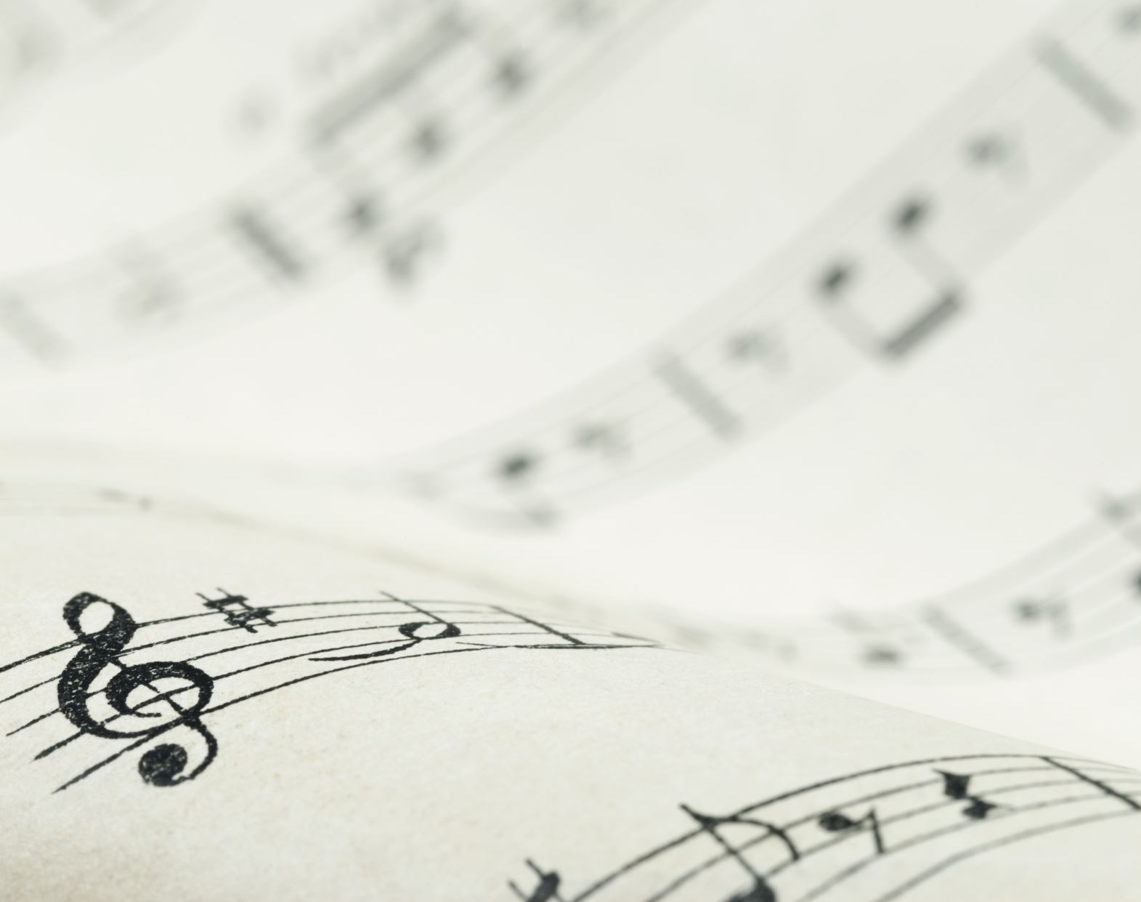
Choir Loft Risers
The installation of these risers will allow the voices of our choir to project the joy of our celebration of the Mass. They will be placed in the choir loft directly surrounding the organ we’ve installed.

Slide 24
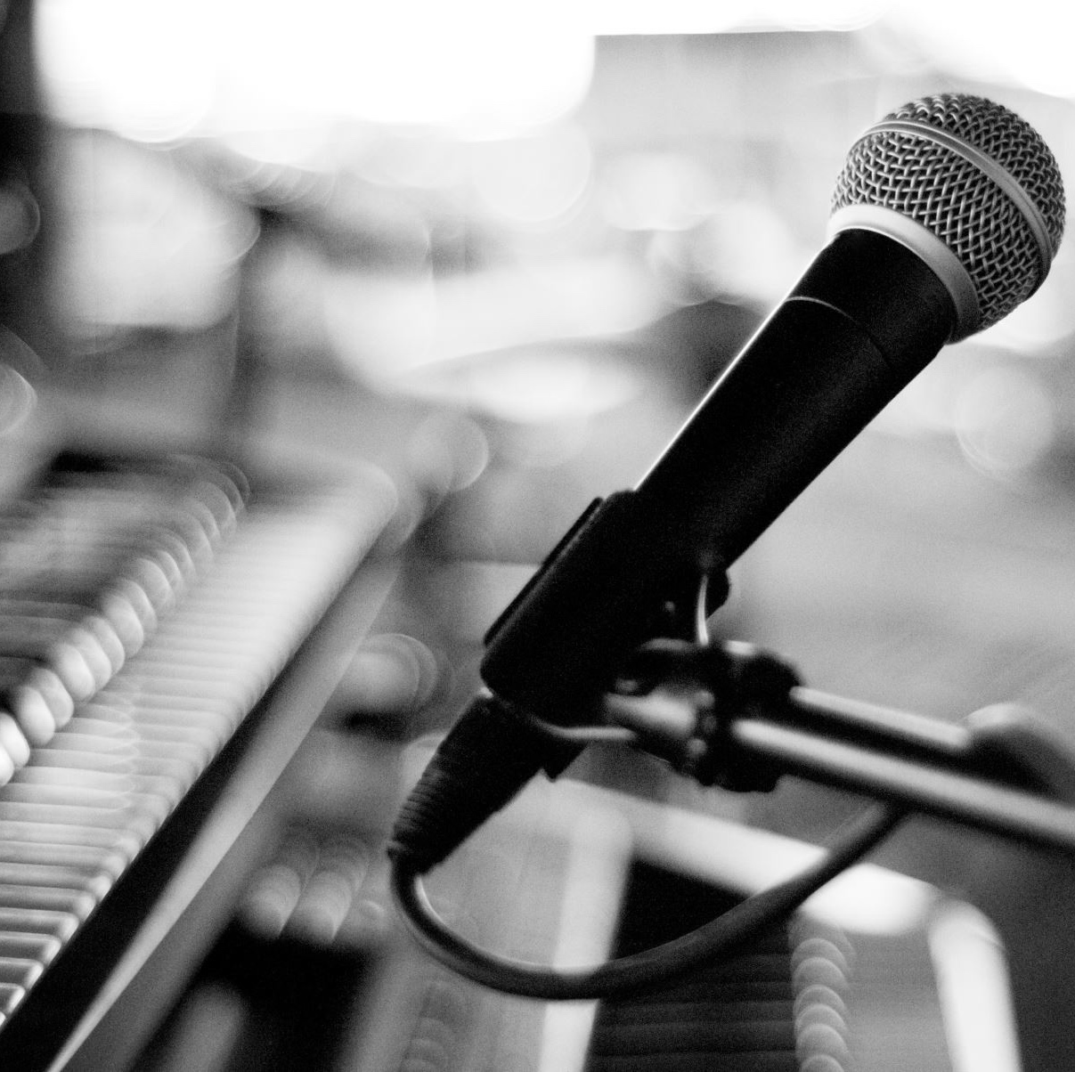
Sound System
The size and majesty of our church demands an audio system that amplifies both the Word of God and the music that is part of our celebration of mass.

Slide 25
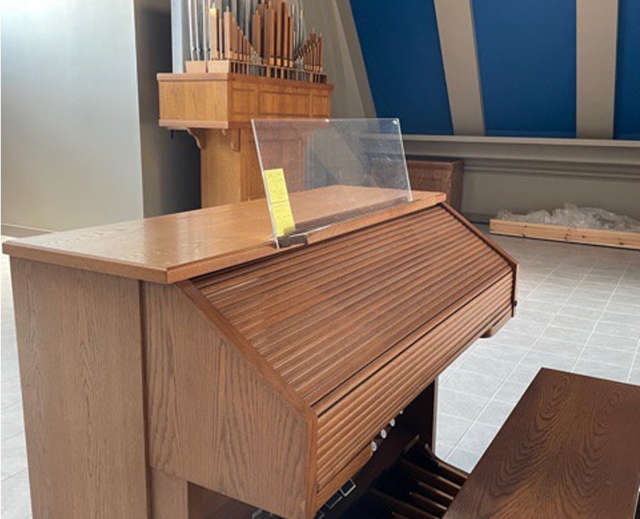
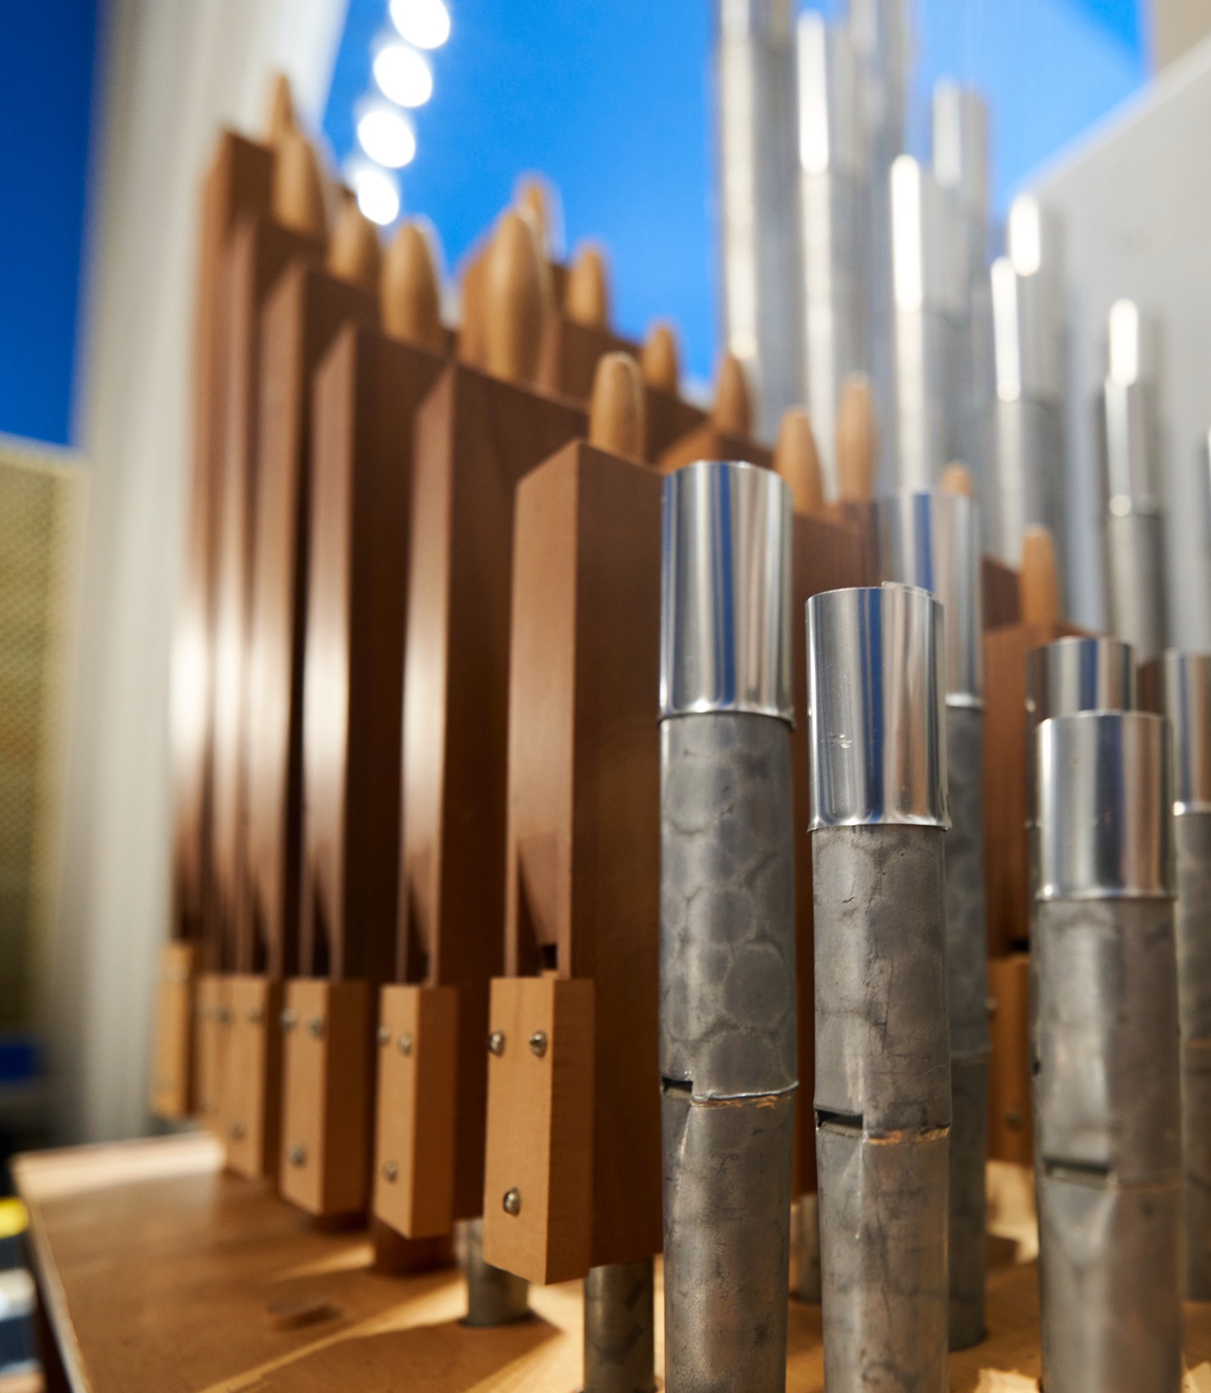
Organ
Most of you have already experienced the added wonder and joy that an organ brings to the celebration of Mass. We have been blessed with a beautifully refurbished organ placed at the focal point of the choir loft.

Slide 26
Asking Donation
(the music)
The Music | Asking Donation | Needed
Choir Loft Risers | $16,000 | 1
The Sound System | $100,000 | 1
Organ | $25,000 | 1
Bronze Choir Railing | $35,000 | 1

Slide 27
The Light
Chandelier | Consecration Wall Candles

Slide 28
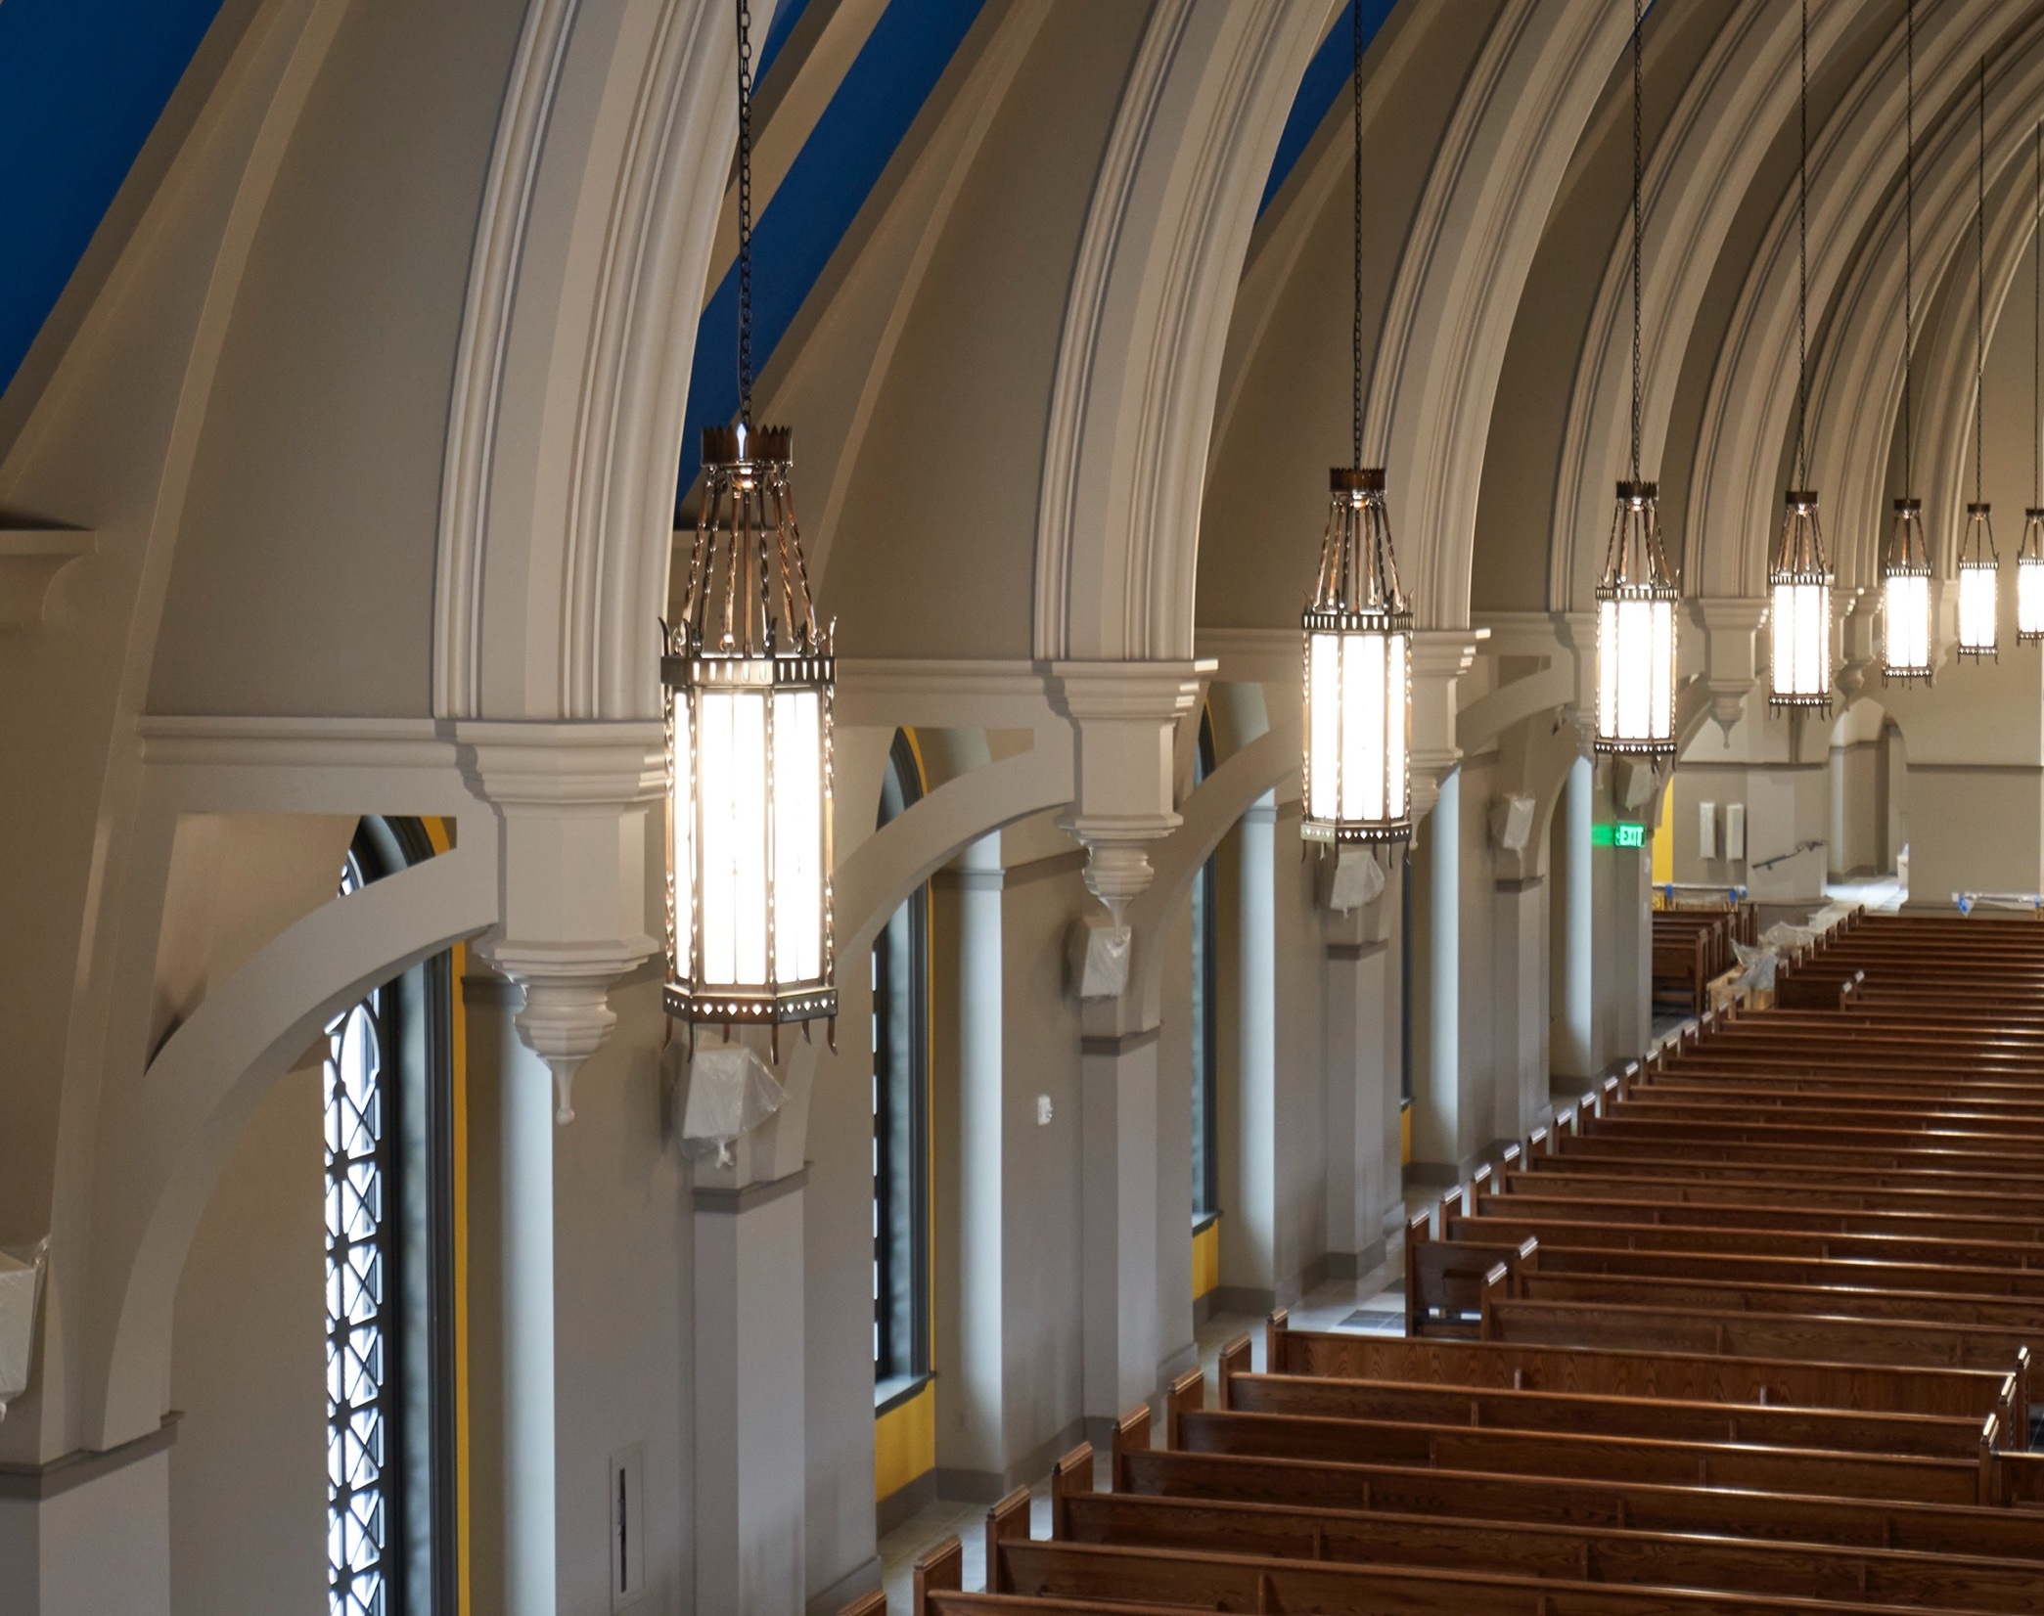
The Chandeliers
These 26 chandeliers hang above the pews on both sides of the aisle in the nave of the church and in the narthex as well.
Like so many features within our parish home, these items were individually hand-crafted. The craftsmen were from Lightsmith/Jefferson Lighting of Lynchburg, VA.

Slide 29
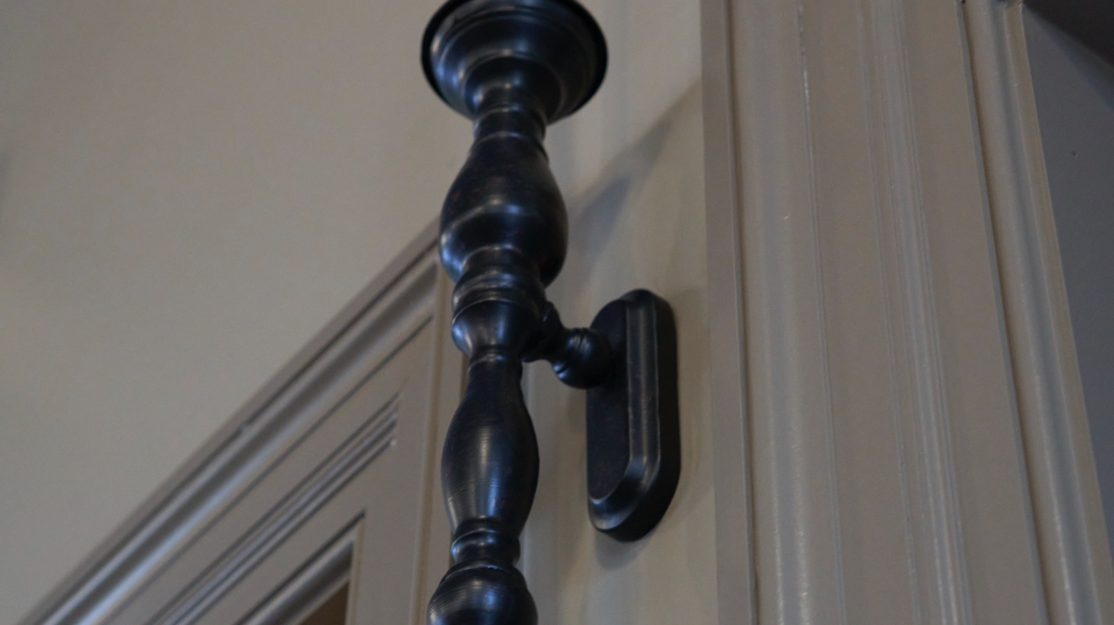
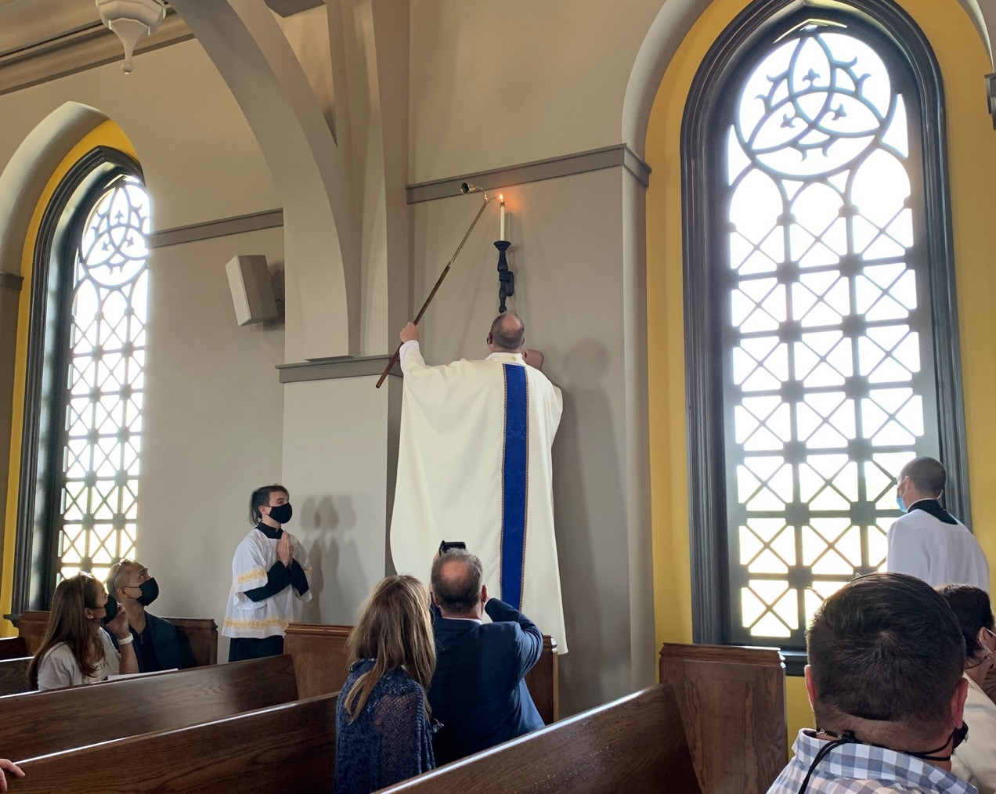
Consecration Wall Candles
Located around the walls you will see twelve candles and close to them twelve stones set into the walls. The stones and altar were solemnly anointed with Sacred Chrism and the candles first lit when the Corpus Christi Catholic Church was consecrated – formally set apart for use as a place where God is worshipped – on May 2, 2021.
During the Rite of Dedication when the Altar candles and the Dedication candles are lit at the same time, the Bishop says, “Let the light of Christ shine brightly in the Church, that all nations may attain the fullness of truth.” It is also a custom in some Churches to light them on the parish feast day as well as on the anniversary of the dedication.
The candles light and point the way to the consecration stones embedded in the walls which are anointed during the Church dedication ceremony.

Slide 30
Asking Donation
(the light)
The Light | Asking Donation | Needed
Chandelier | $2,000 | 15
Consecration Wall Candles | $2,000 | 9

Slide 31
The Prayer
Church Pews | Donor Book

Slide 32
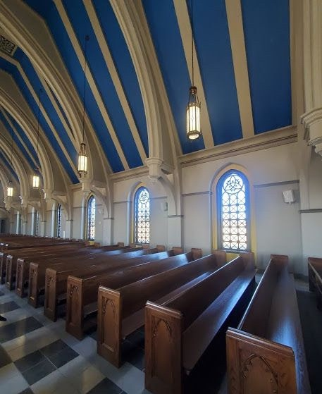
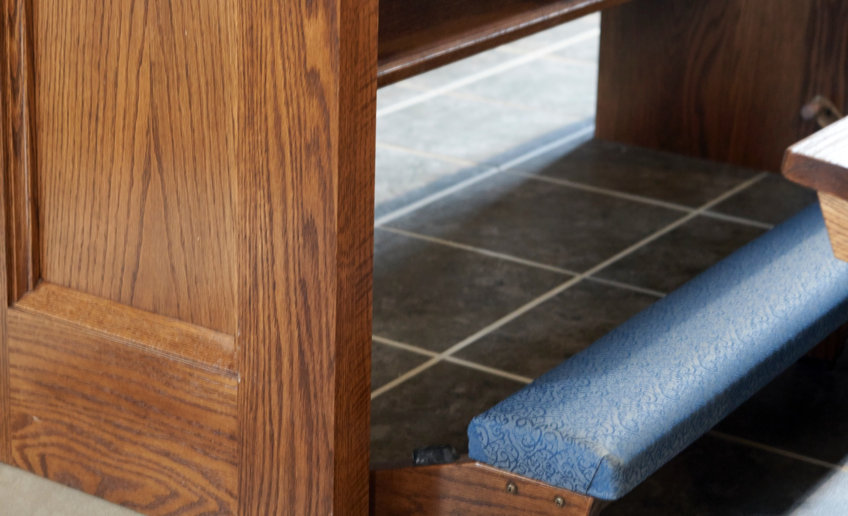
The Pews
Our pews were newly built for Corpus Christi and each is faced with beautiful woodwork at the end piece. The kneelers match the beautiful blue of the ceiling above.

Slide 33
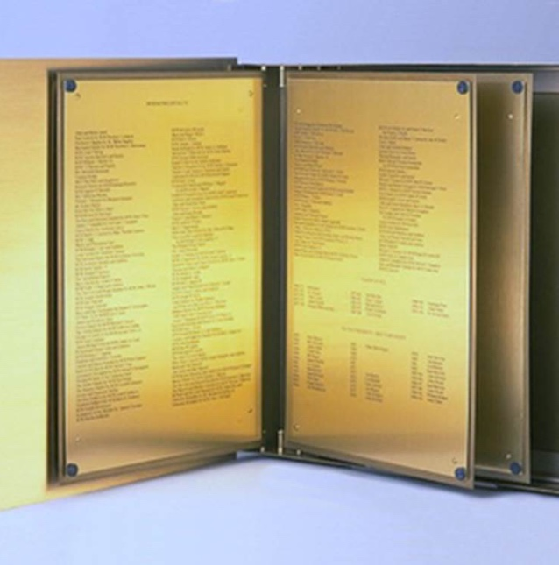
Donor Book
Our plan for recognition is two-fold
  The donor book is at the entrance of the church listing all those who have contributed thus far to the Capital Campaign
  The book also recognizes those who have memorialized church furnishings
  New donors will be added annually

Slide 34
Asking Donation
(the prayer)
The Prayer | Asking Donation | Needed
Pews | $2,000 | 72
Donor Book | $7,500 | 1

Slide 35
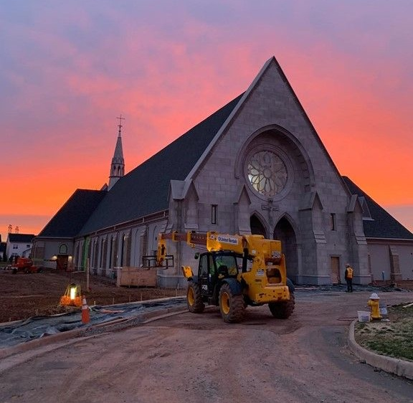
Questions?
Contact the parish office: phone: 703-378-0763 email: info@corpuschristisr.org

